Slide 1
Energy Resources:
Production and Consumption
Environmental Sustainability Educational Resources
prepared by
Gregory A. Keoleian
Associate Research Scientist,
School of Natural Resources and Environment
Co-Director, Center for Sustainable Systems
University of Michigan

Slide 2
Contents
Non-Renewable Energy Resources [slide 3]
Renewable Energy Sources [slide 4]
Peak Production of Petroleum in US [slide 5]
Projected World Peak Production of Petroleum [slide 6]
Projected World Peak Production of Petroleum [slide 7]
Regional Shares of Crude Oil [slide 8]
World Oil Production [slide 9]
World Total Primary Energy Supply [slide 10]
World Total Energy Consumption Projections [slide 11]
World Total Energy Consumption Projections (by fuel type) [slide 12]
World Total Energy Consumption 1990 -2020 (by region) [slide 13]
U.S. Energy Flow [slide 14]
U.S. Energy Consumption and Renewable Supply [slide 15]
Additional Resources [slide 16]

Slide 3
Non-Renewable Energy Sources
Conventional
  Petroleum
  Natural Gas
  Coal
  Nuclear
Unconventional (examples)
  Oil Shale
  Natural gas hydrates in marine sediment
Notes:
Non-renewable energy sources include fossil fuels and nuclear sources that are essentially finite in the earth’s crust. These represent the energy resource endowment for current and future generations.
These resources can be classified further as conventional and unconventional. Unconventional resources are not currently exploited at significant levels generally because they can not be economically extracted and/or refined.
Oil shale is source rock that has not yet released its oil. In the 1970’s it was thought to be the answer to US energy self-sufficiency. Oil shale is pulverized and heated to 500 -1000 C (pyrolyzed, but the oil requires further upgrading before a refinery can use it as a feedstock.
Natural gas hydrates in marine sediment are a mixture of methane and H2O frozen into solid crystalline state at water depths of approximately 500m. It is derived from the decay of organic matter trapped in the sediment. It has been estimated that this resource is as large as 2x all known fossil fuels.

Slide 4
Renewable Energy Sources
Solar photovoltaics
Solar thermal power
Passive solar air and water heating
Wind
Hydropower
Biomass
Ocean energy
Geothermal
Waste to Energy

Slide 5
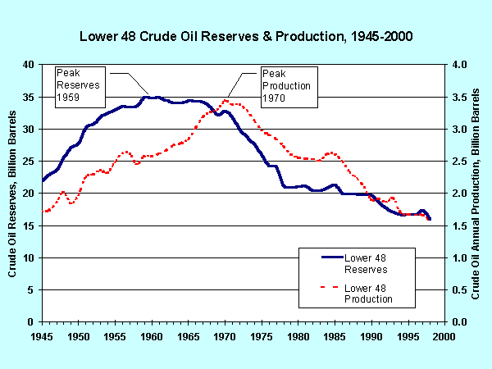
Peak Production of Petroleum in US
Notes:
Source: EIA, Long Term World Oil Supply (A Resource Base/Production Path Analysis) 07/28/2000, Authors: John Wood, Gary Long
1. The graph shows proved reserves and production of conventional oil for the lower-48 States and the continental shelf.
2. M. King Hubbert, in his famous 1956 paper “Nuclear Energy and the Fossil Fuels” (Drilling and Production Practices, American Petroleum Institute, Washington, DC, 1956), predicted that Lower-48 States oil production would peak in 1965 if the assumed ultimate cumulative production were 150 billion barrels or in 1970 if the assumed ultimate cumulative production were 200 billion barrels.
3 For the United States, actual production peaked in 1970.
4. Hubbert also predicted that proved reserves of oil would peak before production peaked, and U.S. proved reserves did so in 1959. These U.S. reserves and production peaks still look like they will be the all-time peaks.
5. The United States experience conforms to the expected nature of the production cycle of a finite resource - and conventional oil is a finite resource.
6. Although market mechanisms such as higher prices and/or the application of new discovery, production, or end-use technologies might delay the peak and/or slow the decline, eventually production will peak and then fall for any finite resource.
7. If one can estimate the ultimate cumulative production (ultimate recovery) and the rates of production increase up to the peak and decline after the peak, then it is straightforward to predict when the production peak will occur. We’ll demonstrate this later in the presentation.

Slide 6
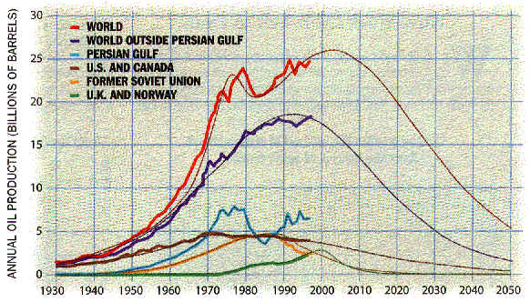
Projected World Peak Production of Petroleum
Notes:
Source: THE END OF CHEAP OIL by Colin J. Campbell and Jean H. Laherrère, Scientific American, March 1998
The authors conclude that oil production will begin to decline before 2010.
One of the most recent - and controversial - projections of the world conventional oil resource production path used a Hubbert-like methodology. The estimators were Colin Campbell and Jean Laherrère, whose results were published in Scientific American (“The End of Cheap Oil?,” March 1998).
As shown in this graph, they predicted that world oil production would peak in 2004, very soon indeed. However, Campbell-Laherrère made assumptions that not all analysts agree with, including their estimate of the world oil resource base (1.8 trillion barrels of recoverable oil).

Slide 7
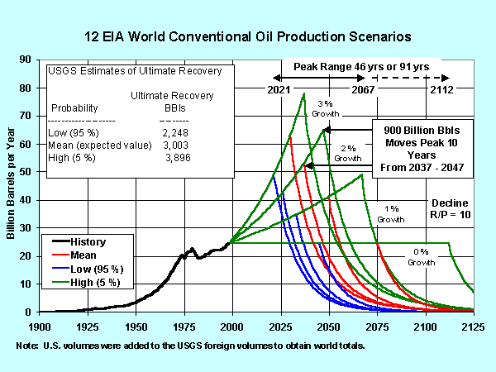
Notes:
Source: EIA, Long Term World Oil Supply (A Resource Base/Production Path Analysis) 07/28/2000, Authors: John Wood, Gary Long
1. This summary graph shows all 12 long-term production scenarios based on the 4 annual production growth rates (0, 1, 2, and 3 percent) and the 3 USGS technically recoverable oil resource volumes (2,248, 3,003, and 3,896 billion barrels) equivalent to the 95 percent probable, mean (expected value), and a 5 percent probable volumes.
2. The estimated peak year of production ranges from 2021 to 2067 (a span of 46 years) for the 1, 2, and 3 percent per year growth rates and the 3 resources volumes. Including the 0 percent growth rate extends the estimated production peak range to 2112 (a span of 91 years). For the mean resource and 2 percent production growth rate scenario, which reflect the expected resource volume and the recently experienced production growth rate, the peak occurs in 2037.
3. Market feedback mechanisms might smooth and flatten the sharp production peaks as the actual production paths play out, moving the peaks earlier in time.
4. The peak year would be delayed by discovery of a larger recoverable conventional resource base than is currently estimated, or it could occur earlier with accelerated production rates. It may also vary as global oil demand varies. For example, if demand for oil weakens for economic reasons or because substitutes for conventional oil gain market share, the conventional oil production growth rate may decline and result in a later peak.

Slide 8
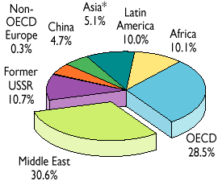
1999 Regional Shares of Crude Oil Production (3445 Mt)
Notes:
Source: KEY WORLD ENERGY STATISTICS from the IEA

Slide 9
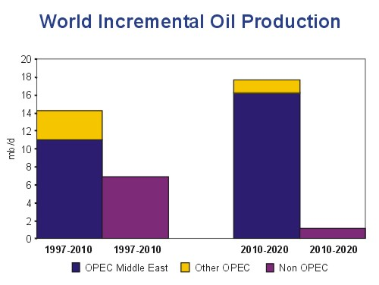
Notes:
Source: KEY WORLD ENERGY STATISTICS from the IEA
Oil remains the dominant fuel in the primary energy mix with a share
of 40% in 2020, as a result of 1.9% annual growth over the projection
period. This is almost identical to its share today. The volume of world oil
demand is projected at close to 115 million barrels per day in 2020,
compared to 75 mb/d in 1997. In the OECD countries, the transport
sector accounts for all oil-demand growth. In non-OECD regions,
transportation accounts for most of the growth in oil use, but the
household, industry and power-generation sectors also contribute.

Slide 10
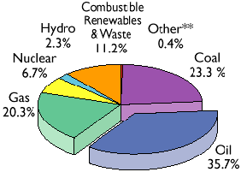
World Total Primary Energy Supply in 1998
(9491 Mtoe)
**Other includes geothermal, solar, wind, heat, etc.
Notes:
Source: KEY WORLD ENERGY STATISTICS from the IEA
http://www.iea.org/statist/keyworld/keystats.htm
1 Mtoe (million tonnes of oil equivalents) = 4.1868 x 10 4 TJ (tera Joules) = 10 7 Gcal

Slide 11
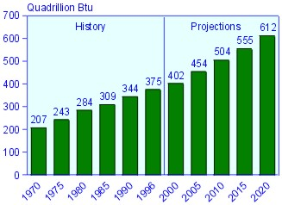
World Energy Consumption
Notes:
http://www.eia.doe.gov/oiaf/ieo/index.html#highlights
World Energy Consumption, 1970-2020.
Sources: History: Energy Information Administration (EIA), Office of Energy Markets and End Use, International Statistics Database and International Energy Annual 1997, DOE/ EIA-0219(97) (Washington, DC, April 1999). Projections: EIA, World Energy Projection System (2000).
In the reference case projections for the International Energy Outlook 2000 (IEO2000), world energy consumption increases by 60 percent over a 23-year forecast period, from 1997 to 2020. Energy use worldwide increases from 380 quadrillion British thermal units (Btu) in 1997 to 608 quadrillion Btu in 2020

Slide 12
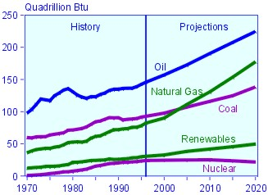
World Energy Consumption
Notes:
World Energy Consumption by Fuel Type, 1970-2020.
Sources: History: Energy Information Administration (EIA), Office of Energy Markets and End Use, International Statistics Database and International Energy Annual 1997, DOE/ EIA-0219(97) (Washington, DC, April 1999). Projections: EIA, World Energy Projection System (2000).
Oil currently provides a larger share of world energy consumption than any other energy source and is expected to remain in that position throughout the forecast period. Its share of total energy consumption declines slightly, however, from 39 percent in 1997 to 38 percent in 2020, as countries in many parts of the world switch to natural gas and other fuels, particularly for electricity generation.
Natural gas remains the fastest growing component of primary world energy consumption. Over the IEO2000 forecast period, gas use is projected to more than double in the reference case, reaching 167 trillion cubic feet (Figure 7). The gas share of total energy consumption increases from 22 percent in 1997 to 29 percent in 2020.
http://www.eia.doe.gov/oiaf/ieo/index.html#highlights

Slide 13
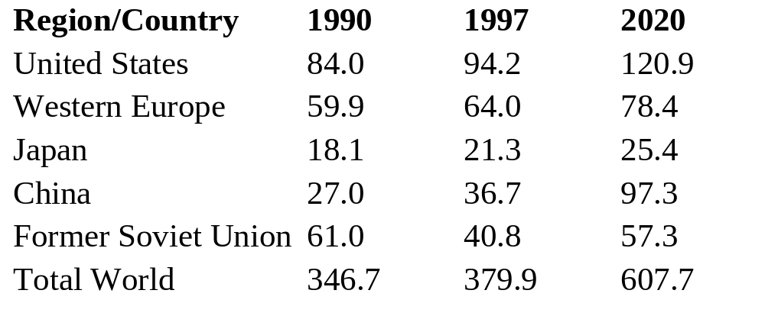
World Total Energy Consumption 1990 -2020 (Quadrillion Btu)
Notes:
In the International Energy Outlook (IEO) 2000 reference case, much of the growth in worldwide energy use is projected for the developing world (Figure 3). In particular, energy demand in developing Asia and Central and South America is projected to more than double between 1997 and 2020. Both regions are expected to sustain energy demand growth of more than 3 percent annually throughout the forecast, accounting for more than one-half of the total projected increment in world energy consumption and 83 percent of the increment for the developing world alone. http://www.eia.doe.gov/oiaf/ieo/tbla1_a8.html
Sources: History: Energy Information Administration (EIA), International Energy Annual 1997, DOE/EIA-0219(97) (Washington, DC, April 1999). Projections: EIA, Annual Energy Outlook 2000, DOE/EIA-0383(2000) (Washington, DC, December 1999), Table A1; and World Energy Projection System (2000).

Slide 14
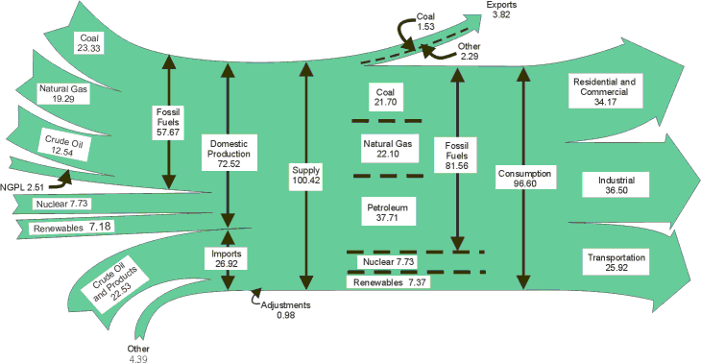
U.S. Energy Flow, 1999
Notes:
In 1999 the United States produced 73 quadrillion British thermal units
(Btu) of energy and exported 4 quadrillion Btu, about 40 percent of it as
coal. Consumption totaled 97 quadrillion Btu, requiring imports of 27 qua-drillion Btu, 18 times the 1949 level.
Energy plays a central role in the operation of the industrialized U.S. economy,
and energy spending is commensurately large. In recent years, American
consumers have spent over half a trillion dollars a year on energy.
That energy is consumed in three broad end-use sectors: the residential and
commercial sector, the industrial sector, and the transportation sector. Industry,
historically the largest consuming sector of the economy, ran just
ahead of the residential and commercial sector in recent years, followed by
the transportation sector.
Source: Energy Information Administration/Annual Energy Review 1999

Slide 15
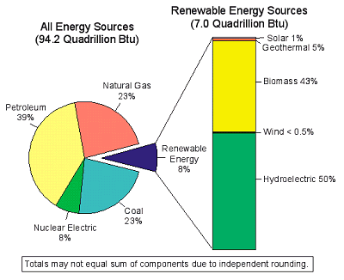
U.S. Energy Consumption by Source, 1998
Notes:
Quad = quadrillion Btu = 10 ¹⁵ Btu
Only 8% of the total U.S. energy consumption comes from renewable sources. Hydroelectric power and biomass continued to dominate the renewable energy market, with 50 percent and 43 percent shares, respectively.
Source: Renewable Energy Annual 1999, Energy Information Administration

Slide 16
Additional Resources
US Department of Energy, Energy Information Administration
  web site: www.eia.doe.gov

